Slide 1
Building the business migration case with Linux and OSS DB to Azure

Slide 2
Abstract and learning objectives
In this whiteboard design session, you will learn to design a strategy for migrating existing on-premises Red Hat Enterprise Linux (RHEL) and MySQL database workloads to Azure. Throughout the whiteboard design session, you will look at the virtual machine (VM) pricing and migrating MySQL database workloads to Azure.
At the end of the workshop, you will be better able to design a migration strategy for Red Hat Enterprise Linux (RHEL) workloads to Azure VMs and MySQL database workloads to Azure Database for MySQL.

Slide 3
Step 1: Review the customer case study
Outcome
Analyze your customer needs.
Timeframe
15 minutes

Slide 4
Customer situation
Terra Firm Laboratories is a global bioengineer company headquartered in Palo Alto, CA.
They are currently hosting mission critical workloads in an on-premises datacenter.
Dennis Nedry, CTO of Terra Firm, has already had their Technical Architects create an assessment of their current environment, of which they’ve already identified the first workload to migrate to Azure.
Their workloads are primarily Red Hat Enterprise Linux (RHEL) VMs and MySQL databases.
Their on-premises environment consists of over 250 Linux servers and VMs.

Slide 5
Customer situation (continued)
They’ve identified an initial workload they’d like to migrate that represents common components across their infrastructure consisting of:
PHP web application hosted using Apache HTTP web server on Red Hat Enterprise Linux (RHEL)
MySQL database server

Slide 6
Customer needs
Migrate existing workloads to Azure as efficiently as possible.
Security is extremely important when integrating the on-premises network and workloads with Microsoft Azure.
Improve the business continuity and disaster recover position of the workloads that are migrated to Azure.

Slide 7
Customer objections
What are the options to roll back to the on-premises VMs if the migration fails?
What options does Azure provide for utilizing existing Red Hat Subscription to save on Red Hat Enterprise Linux (RHEL) VM cost in the cloud?
Securing and monitoring our on-premises workloads is extremely important. What options does Azure offer to extend this into the cloud?
What options are there for PaaS hosting in Azure and would they offer additional cost savings?

Slide 8
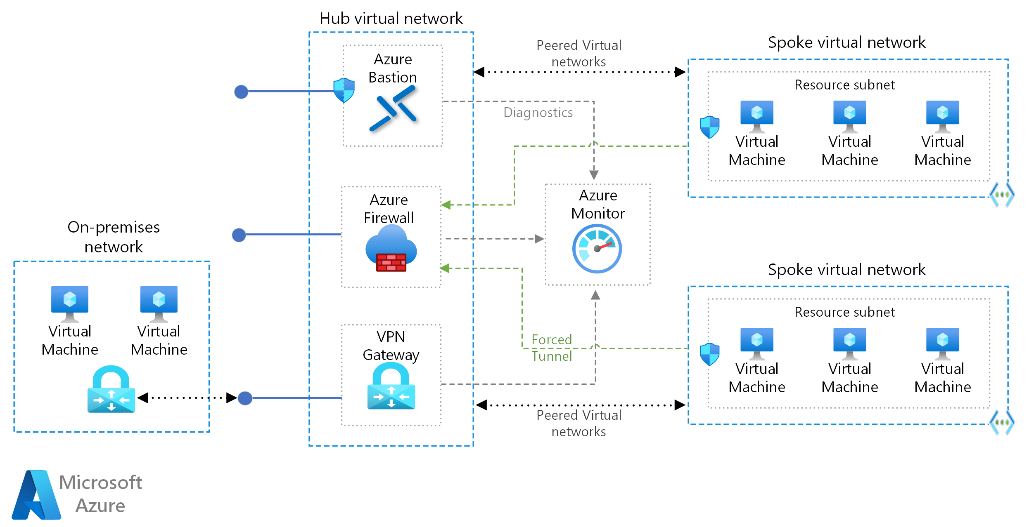
Common scenarios
Notes:
The hub virtual network acts as a central point of connectivity to many spoke virtual networks. The hub can also be used as the connectivity point to your on-premises networks. The spoke virtual networks peer with the hub and can be used to isolate workloads.
https://docs.microsoft.com/azure/architecture/reference-architectures/hybrid-networking/hub-spoke

Slide 9
Step 2: Design the solution
Outcome
Design a solution and prepare to present the solution to the target customer audience in a 15-minute chalk-talk format.
Timeframe
60 minutes
Business needs (10 minutes) | Respond to questions outlined in your guide and be prepared to present your solutions to others.
Design (35 minutes) | Design a solution for as many of the stated requirements as time allows.
Prepare (15 minutes) | Identify any customer needs that are not addressed with the proposed solution. Identify the benefits of your solution. Determine how you will respond to the customer’s objections. Prepare for a 15-minute presentation to the customer.

Slide 10
Step 3: Present the solution
Outcome
Present a solution to the target customer in a 15-minute chalk-talk format.
Timeframe
30 minutes (15 minutes for each team to present and receive feedback)
Directions
Pair with another team.
One group is the Microsoft team and the other is the customer.
The Microsoft team presents their proposed solution to the customer.
The customer asks one of the objections from the list of objections in the case study.
The Microsoft team responds to the objection.
The customer team gives feedback to the Microsoft team.
Switch roles and repeat Steps 2-6.

Slide 11
Wrap-up
Outcome
Identify the preferred solution for the case study.
Identify solutions designed by other teams.
Timeframe
15 minutes

Slide 12
Building the business migration case with Linux and OSS DB to Azure
Whiteboard Design Session – Preferred Solution

Slide 13
Preferred target audience
Dennis Nedry, Chief Technology Officer
Technical Architects
Infrastructure Architects
Data Architects

Slide 14
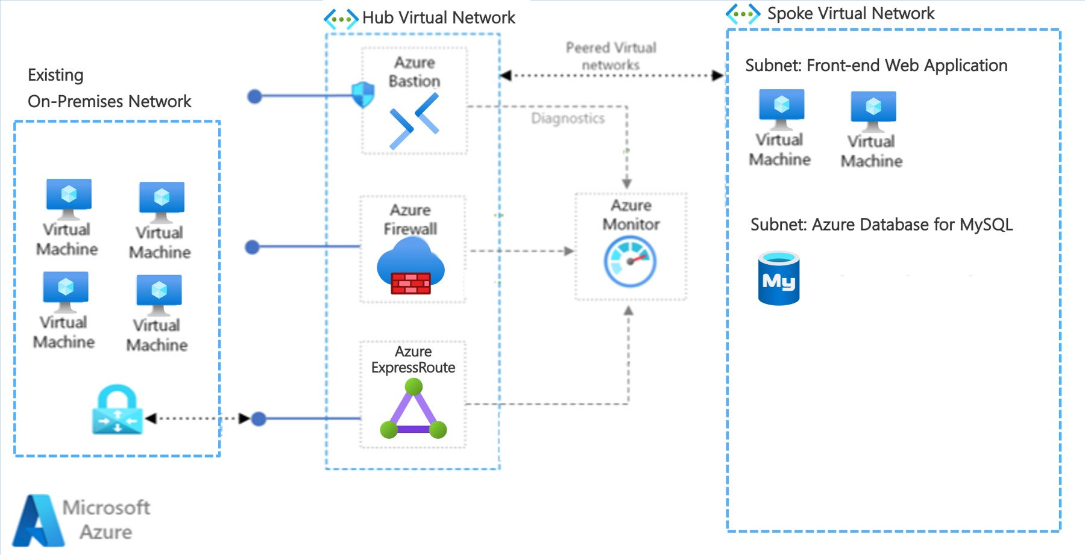
High Level Architecture
Notes:
Terra Firm has Hub and Spoke networking setup with Azure ExpressRoute connected to Azure.
The PHP web application server, and MySQL databases have been migrated to Azure and are running in Virtual Machines and Azure Database for MySQL hosted within a Spoke VNet in Azure that is peered with the Hub VNet.
Each application in Azure is contained within its own Subnet with Network Security Groups securing them accordingly.
Other components that may be setup according to the clients' requirements are:
Azure Bastion for secure Remote Desktop access to Azure VMs
Azure Firewall to protect the Web Application Front End (a common component to use in a secure Azure networking model)
Azure Monitor setup to implement monitoring of Azure VMs

Slide 15
Migration #1
How will you migrate the on-premises PHP workloads to Azure?
Since it is recommended to upgrade the latest version of Red Hat Enterprise Linux, it will be necessary to create new servers. In this case, Azure Migrate can not be used to move the on-premises VMs into Azure as-is. New Azure VMs need to be created with the application workloads deployed to these new Azure VMs.
Application deployment automation is already being done using DevOps practices within Terra Firm Laboratories, so there should be minimal effort necessary to extend those pipelines to deploy to the new Azure VMs in parallel. This parallel deployment will enable the on-premises and Azure VMs to be deployed to simultaneously with the latest source code deployed to both sets of hosting infrastructure.

Slide 16
Migration #2
How will you migrate the on-premise MySQL database workloads to Azure?
The MySQL databases will be migrated to Azure Database for MySQL. The Azure Database for MySQL service will utilize VNet integration to securely connect to the Spoke VNET in the Hub and Spoke network topology.
The MySQL databases will be migrated using the Azure Database Migration Service to perform a one-time full database migration from the on-premises MySQL databases to Azure Database for MySQL. During the migration process the on-premises MySQL databases will remain until the cutover to Azure Database for MySQL is verified.

Slide 17
Pricing #1
What is the estimated cost for the workloads after being migrated to Azure IaaS?
Since Terra Firm and their current on-premises datacenter is in Palo Alto, CA, the nearest Azure Region to use will be West US.
There will need to be additional discussions with Terra Firm Laboratories to determine the extent of Disaster Recovery (DR) they require for this initial set of workloads being migrated to Azure.

Slide 18
Pricing #1 (continued)
Component | On-Premises | Azure VM Sizes
Red Hat Enterprise Linux VMs (web application) | 2x VMs (2 Cores, 16 GB RAM) | 2x D4s v5 VMs (4 vCores, 16 GiB RAM)
MySQL database server | 2x VMs (8 Cores, 64 GB RAM) | Azure Database for MySQL Flexible Server D8 v4 (8 vCores, 32 GiB RAM)
When choosing Azure VM Sizes, the nearest size to what’s currently on-premises is shown above.

Slide 19
Pricing #1 (continued)
Component | Region | Details / Assumptions | Est. Monthly Cost (USD)
Red Hat Enterprise Linux VMs (web application) | West US | 2x D4s v5 VMs (4 vCores, 16 GiB RAM) & RHEL w/ Hybrid Benefit | $62.13 each
Azure Database for MySQL | West US | Flexible Server D8 v4 (8 vCores, 32 GiB RAM) | $261.75
The D4 v5 VM pricing estimate is for Azure Hybrid Benefit (AHB) pricing with 3 year reserved instance.
The Azure Database for MySQL Flexible Server D8 v4 pricing estimate is for a 3 year reserved instance.

Slide 20
Pricing #1 (continued)
Component | Est. Monthly Cost (USD)
Red Hat Enterprise Linux VMs (web application) | 2x $62.13
Azure Database for MySQL | $261.75
Total | $386.01

Slide 21
Pricing #1 (continued)
The D4 v5 VM pricing estimate is for Azure Hybrid Benefit (AHB) pricing with a 3 year reserved instance. For Pay as you go with AHB the estimated cost would be $163.52 per month for each VM. Reserved instances offer a much lower cost.
The MySQL cost estimates do not include storage or additional IOPS since the total cost of these will vary depending on the database usage.

Slide 22
Pricing #2
What is the estimated cost for the web application workloads if migrated to Azure PaaS?
Since Terra Firm and their current on-premises datacenter is in Palo Alto, CA, the nearest Azure Region to use will be West US.
There will need to be additional discussions with Terra Firm Laboratories to determine the extent of Disaster Recovery (DR) they require for this initial set of workloads being migrated to Azure.

Slide 23
Pricing #2 (continued)
For hosting the PHP web application in Azure using a PaaS service, then Azure App Service is the most appropriate service.
App Service also support VNet integration enabling integration with the Hub and Spoke networking topology to meet the security requirements of Terra Firm.

Slide 24
Pricing #2 (continued)
Component | Region | Details / Assumptions | Est. Monthly Cost (USD)
Azure App Service Plan (PHP web app) | West US | P2v3 (4 vCores, 16 GB RAM) | $295 each
Azure Database for MySQL | West US | Flexible Server D8 v4 (8 vCores, 32 GiB RAM) | $261.75
The App Service Plan P2v3 pricing estimate is for 3 year reserved instance.
Azure Database for MySQL estimate remains same as for IaaS since this is a PaaS service already.

Slide 25
Pricing #2 (continued)
A comparison of the estimated cost of a single VM to Azure App Service as estimated in the preferred solution shows that PaaS hosting using Azure App Service costs more.
It's important to remember that with Azure App Service being a fully managed service, the overall maintenance costs for IT Admins will be lower.
Further consultation will need to be performed with Terra Firm to determine how much administration time will be saved by hosting on Azure App Service instead of VMs.

Slide 26
Preferred objections handling #1
Objection
What are the options to roll back to the on-premises VMs if the migration fails?
Potential answer
The migration process will be designed to create new application deployments to the new Red Hat Enterprise Linux VMs in Azure in parallel to the existing on-premises VMs. This will allow traffic to be cut over to the new VMs when ready.
In the event of an unexpected issue during migration, the existing on-premises VMs, application deployments, and databases will remain in place as a fallback. If there is an issue detected during the cutover process, the on-premises servers will be able to immediately pick up where they left off.

Slide 27
Preferred objections handling #2
Objection
What options does Azure provide for utilizing existing Red Hat Subscription to save on Red Hat Enterprise Linux (RHEL) VM cost in the cloud?
Potential answer
Azure Hybrid Benefit (AHB) for pay-as-you-go virtual machines or virtual machine scale sets (Flexible orchestration mode only) is an optional licensing benefit. It significantly reduces the cost of running Red Hat Enterprise Linux (RHEL) and SUSE Linux Enterprise Server (SLES) virtual machines in the cloud.
After Azure Hybrid Benefit is applied to a RHEL or SLES virtual machine, you are no longer charged a software fee. Your virtual machine is charged a BYOS (bring your own subscription) fee instead.

Slide 28
Preferred objections handling #3
Objection
Securing and monitoring our on-premises workloads is extremely important. What options does Azure offer to extend this into the cloud?
Potential answer
Microsoft Defender for Cloud is a solution for cloud security posture management (CSPM) and cloud workload protection (CWP) that finds weak spots across your cloud configuration, helps strengthen the overall security posture of your environment, and can protect workloads across multi-cloud and hybrid environments from evolving threats.
Azure Monitor collects monitoring telemetry from a variety of on-premises and Azure sources. Management tools, such as those in Azure Security Center and Azure Automation, also push log data to Azure Monitor. The service aggregates and stores this telemetry in a log data store that’s optimized for cost and performance. Analyze data, set up alerts, get end-to-end views of your applications, and use machine learning–driven insights to quickly identify and resolve problems.

Slide 29
Preferred objections handling #4
Objection
What options are there for PaaS hosting in Azure, and would they offer additional cost savings?
Potential answer
Further evaluation of the applications will be necessary to determine the requirements for hosting these applications using Azure App Service. App Service Web Apps provide a PaaS hosting option for applications that further reduce the management burden over IaaS VMs. It supports applications built with PHP among other development languages, as well as running on a Linux host for the Web App.
Azure Kubernetes Service (AKS) is another potential option for hosting applications. For Terra Firm, this may not be the best option as it would likely require redesign of the applications to host in AKS. If Azure App Service doesn't meet their requirements, then AKS may offer an alternative that fits better.

Slide 30
Customer quote
“We recognized the need and benefits of migrating our aging infrastructure to Azure. I know this migration is going to help us increase reliability while lowering operation and maintenance costs. I'm really looking forward modernizing with cloud infrastructure that will allow us to do more with less.”
— Dennis Nedry, CTO, Terra Firm Laboratories

